Slide 1

UNIFIED CYBER THREAT DETECTION AND INCIDENT MANAGEMENT SYSTEM
2111CS040005 P . Aditya Sriram
Under the Guidance of
Dr. G. Anand Kumar
(H0D – CS & IOT)
Department of Cyber Security
School of Engineering
Malla Reddy University
Hyderabad, Telangana, INDIA

Slide 2
Contents:
Abstract
1.Introduction
1.1 Problem Definition & Description
1.2 Objectives of the Project
1.3 Scope Of Project
2. System Analysis
2.1 Existing System
2.2 Proposed System
2.3 Software and Hardware Requirements
3. Architectural Design
3.1 Complete Architecture
3.2 Data Flow/Process Flow Diagram
3.3 Use Case Diagram
3.4 Activity Diagram
3.5 Sequence Diagram

Slide 3
ABSTRACT
The Unified Cyber Threat Detection and Incident Management System is a cutting-edge solution designed to enhance organizational security by integrating advanced Security Information and Event Management (SIEM) capabilities. This system provides centralized monitoring, real-time threat detection, and automated incident response to mitigate cyber risks effectively. By leveraging SIEM technology, consolidates security events from diverse sources across an organization’s IT infrastructure, enabling comprehensive analysis and correlation of potential threats. The system’s proactive threat intelligence helps security teams detect anomalies, prevent breaches, and respond to incidents swiftly.. With its robust incident management capabilities, streamlines security operations, ensuring rapid identification, investigation, and mitigation of cyber threats. This holistic approach strengthens an organization’s security posture, minimizes downtime, and ensures business continuity in an ever-evolving digital landscape.

Slide 4
1. Introduction
1.1 Problem Definition & Description
The rise in complex and frequent cyber threats presents significant challenges for organizations in securing their applications and systems. Traditional security measures often fail to detect and mitigate evolving threats, leading to data breaches, financial losses, and reputational damage. To address this issue, the project focuses on developing a Unified Cyber Threat Detection and Incident Management System that analyzes system events recorded by SIEM tools. The Unified Cyber Threat Detection and Incident Management System will also integrate cloud connectivity to improve its capabilities. By leveraging cloud infrastructure, the system can remotely deploy patches, updates, and security controls, allowing organizations to respond swiftly to emerging threats. This proactive approach will help maintain the integrity, confidentiality, and availability of applications and systems. Overall, the project aims to provide a robust security solution that strengthens organizations’ defenses against cyber threats.

Slide 5
1.2 Objectives of the Project
The Unified Cyber Threat Detection and Incident Management System aims to develop an advanced security solution to help organizations safeguard their applications and systems from evolving cyber threats. By leveraging SIEM tools, the system will centralize security event monitoring, enabling real-time analysis of system activities to detect vulnerabilities and potential threats. Another key objective of the system is to support regulatory compliance by incorporating features that help organizations meet standards such as GDPR, HIPAA, and PCI DSS. The system will provide actionable insights, threat intelligence, and security recommendations, enabling organizations to enhance their defenses while maintaining compliance. Designed for ease of use, it will feature user-friendly interfaces and seamless integration capabilities to ensure smooth deployment and operational efficiency. Through rigorous testing and continuous updates, the project aims to ensure reliability, scalability, and adaptability to evolving threats and regulations, providing long-term security solutions for organizations.

Slide 6
1.3 Scope Of Project
The Unified Cyber Threat Detection and Incident Management System leverages Security Information and Event Management (SIEM) tools to analyze system events, identify vulnerabilities, detect anomalies, and mitigate potential threats within an organization's infrastructure. By centralizing security monitoring, the solution provides comprehensive visibility into network activities. Cloud integration further enhances security capabilities by enabling remote deployment of patches, updates, and control commands to address security incidents efficiently. Ongoing support and maintenance services will be provided to address emerging security threats, update features, and comply with evolving regulations. The project will also emphasize collaboration and knowledge sharing among security professionals, researchers, and stakeholders, fostering continuous improvements in cybersecurity practices and the overall security landscape.

Slide 7
2. System Analysis
2.1 Existing System
Currently many organizations rely on traditional security solutions such as firewalls, antivirus software, and Intrusion Detection/Prevention Systems (IDS/IPS) to protect their infrastructure. While these tools help detect and mitigate threats at the perimeter, they often lack the ability to correlate events from multiple sources and provide real-time insights into security incidents. SIEM (Security Information and Event Management) tools address these limitations by collecting, normalizing, and analyzing logs from various security devices, applications, and endpoints. However, existing SIEM implementations often require manual intervention, which can delay threat response and lead to security gaps. Most SIEM tools, such as Splunk, IBM QRadar, ArcSight, and Microsoft Sentinel, provide centralized event monitoring and log management but may lack automated incident response capabilities or deep integration with cloud security solutions.. The need for a unified system that combines SIEM with automated threat detection, incident response, and cloud-based security controls remains a key challenge for modern cybersecurity operations.

Slide 8
2.2 Proposed System
The proposed system aims to enhance cybersecurity by integrating Wazuh with advanced threat detection, automated incident response, and cloud-based security management. Wazuh a powerful SIEM tool, provides real-time log analysis, correlation, and anomaly detection. The system will centralize security event monitoring by collecting and analyzing logs from various sources, such as network devices, endpoints, firewalls, IDS/IPS, and cloud applications, enabling organizations to detect potential threats more efficiently. To improve incident management, the proposed system will incorporate AI-driven threat intelligence and automated response mechanisms. This will help security teams prioritize and mitigate threats in real-time, reducing manual intervention. Additionally, cloud integration will allow organizations to remotely deploy security patches, updates, and enforce policies, ensuring continuous protection against cyber threats.. Ultimately, this unified system will provide a proactive and scalable approach to cybersecurity, minimizing risks and improving incident response efficiency.

Slide 9
2.3 Software and Hardware Requirements
Software Requirements:
Operating System - windows 10/11, cent OS v7
VirtualBox or Vmware
Kali Linux or Parrot OS
Wazuh
Wazuh Manager
Hardware Requirements:
System processor - Minimum Pentium IV 2.2GHz
Hard Disk – Minimum required of 512Gb
Ram – Minimum required of 16Gb

Slide 10
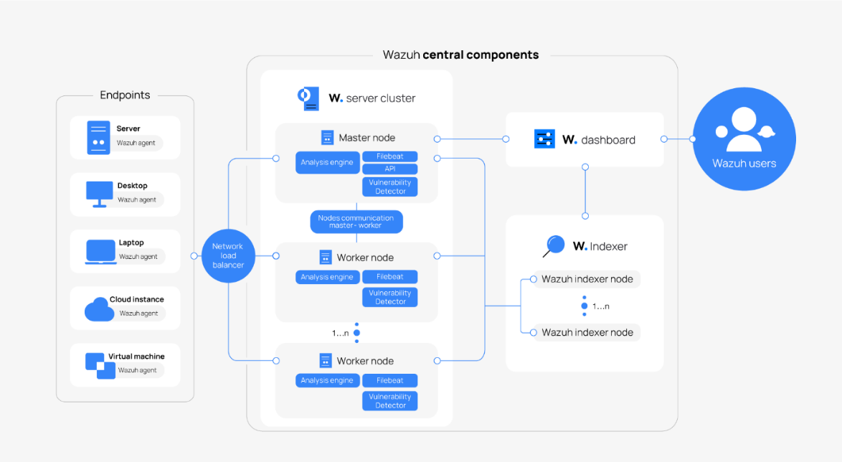
3. Architectural Design 3.1 Complete Architecture

Slide 11
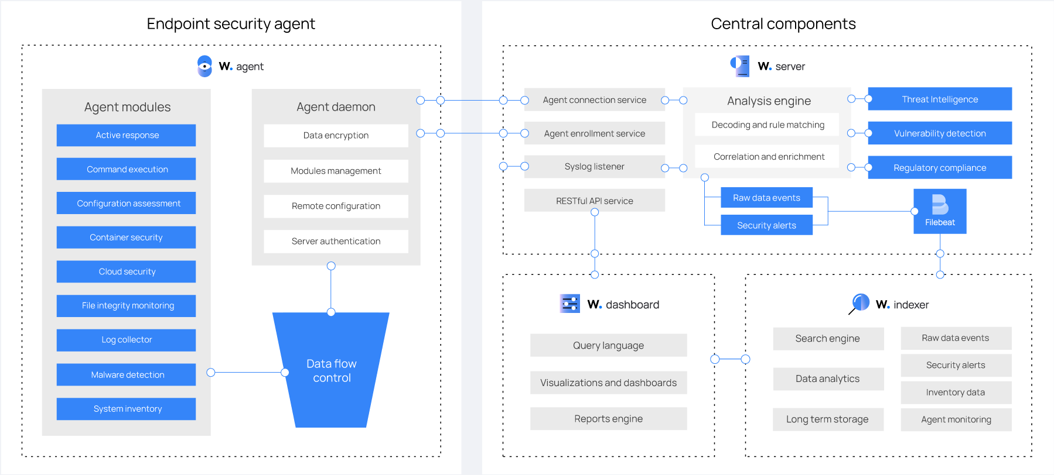
3.2 Data Flow/Process Flow Diagram

Slide 12
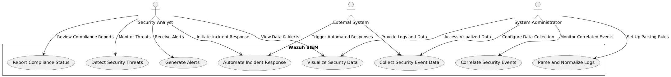
3.3 Use Case Diagram

Slide 13
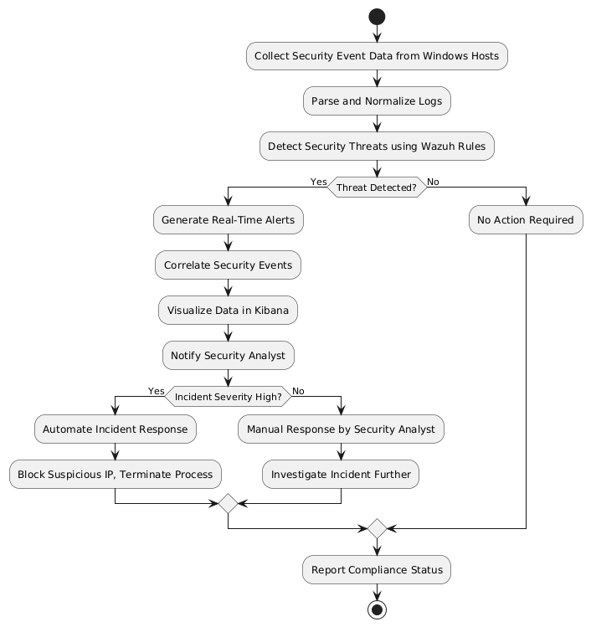
3.4 Activity Diagram

Slide 14
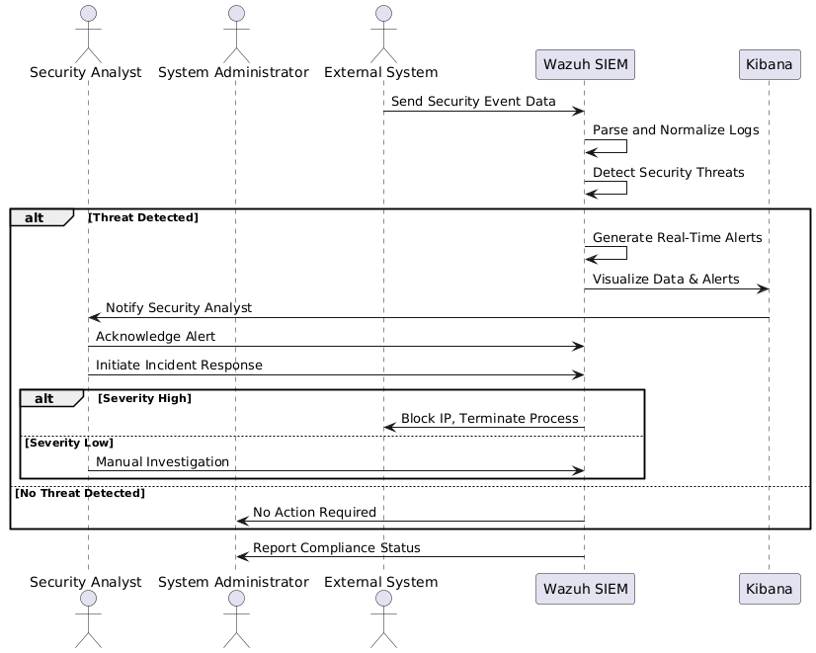
3.5 Sequence Diagram

Slide 15
Thank you

